Slide 1
Cross-platform Mobile App Development
COMP3097 Mobile App Development II
Week 10
Przemyslaw Palwuk

Slide 2



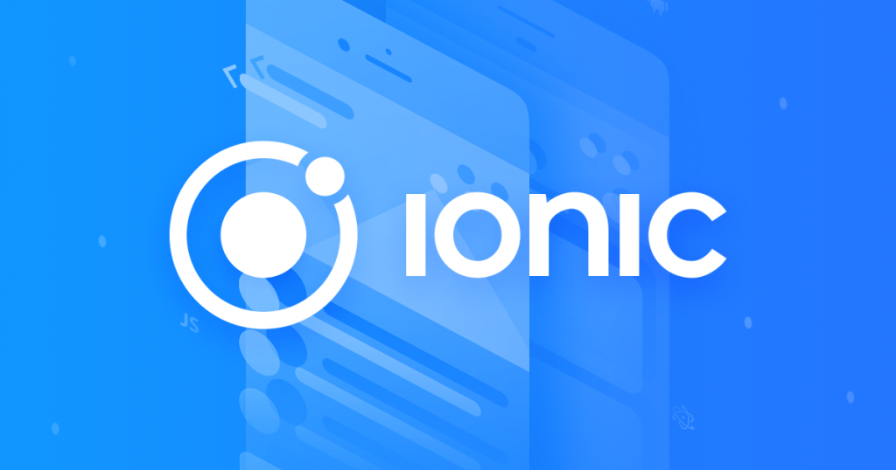
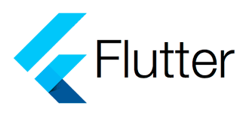
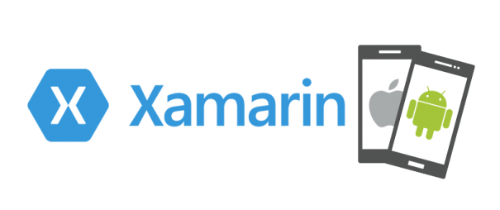

Slide 3
Xamarin is a leading free, open-source platform for building hybrid mobile apps. Xamarin-based solutions are compatible with any mobile platform and provide the same performance and user experience as native solutions.
This popular Microsoft cross-platform mobile app framework relies on the C# programming language complemented with .NET framework and is available under the MIT license as part of Visual Studio. Its development toolset includes the following components:
Xamarin Studio/Visual Studio (its own IDE)
Xamarin SDKs
Xamarin Test Cloud
Xamarin.Mac to build native Mac apps

Slide 4

React Native is one of the top cross-platform mobile development frameworks. It is based on React — a best-in-class JavaScript library for creating user interfaces — and targets mobile platforms.
The great thing about React Native is that you can use a universal JavaScript language as well as Java, Swift, or C — languages specific for native platforms to build cross-platform solutions. Thus, this framework can convert the source code into native elements, contributing to native user experience.
Web developers can easily use React Native to create mobile apps without obtaining new programming skills.

Slide 5

Ionic is definitely among the best hybrid app frameworks as it bridges the properties that are in demand: it’s open-source, easily maintained, scalable, and easy to read. Ionic provides a library of HTML, CSS and JS components optimized for mobile development that helps build interactive apps.
Ionic has a rich set of features and tools, including out-of-the-box support for material design, native-style mobile UI elements and layouts. It also provides its customers with regular updates and resources from the development community.
Ionic-based hybrid applications possess native functionalities, specific gestures and customizable tools that enhance user-friendliness. However, they rely on wrappers such as Cordova or PhoneGap to run as native.

Slide 6
Backed by Adobe, PhoneGap is a distribution of the Cordova framework. This open-source mobile application development framework is usually regarded as the best and the most popular tool for hybrid solutions, not least because of its ease of use.
The tool allows apps to be written in HTML5, CSS3 and JavaScript. It provides native plugins and containers for each mobile platform enabling developers to create more features and access device functionality, such as camera, microphone, accelerometer, compass, file system, and more. After they’re created, apps run in a WebView browser inside a native container on the relevant platform.

Slide 7
Sencha is the leader in enterprise-grade application development, as this comprehensive platform helps teams focus on building applications, not on constructing a framework. This tool is based on modern web technologies, including ES6, HTML5, JavaScript and CSS, so that developers can build data-intensive cross-platform web and mobile applications.
Originally named Sencha Touch, the service is no longer supported and has been merged with Ext JS to create Sencha Ext JS. It has a set of tools and themes that enhance productivity and facilitate optimization, deployment, design, theming and debugging.

Slide 8
How to chose?
The choice of the best solution for hybrid development depends on a host of factors, and the following are the most significant:
The size of the company
Developers’ skills
The needed solution

Slide 9
How to chose?
Without taking these factors into consideration, it is impossible to say which of these tools for hybrid mobile application development is the best.
If you are a small company or an independent developer who wants to create a simple app, you might use Ionic. Large firms, agencies and enterprises that need powerful solutions may opt for Sencha, Xamarin, or other hybrid app development tools.
At the same time, if your priority is smooth performance and a full stack of native features, then native app development is the most appropriate.

Slide 10

Flutter
For Mobile App Development?
Why
Flutter developed by Google, is a cross-platform framework that is used to develop mobile application for Android, iOS and Windows OS.

Slide 11
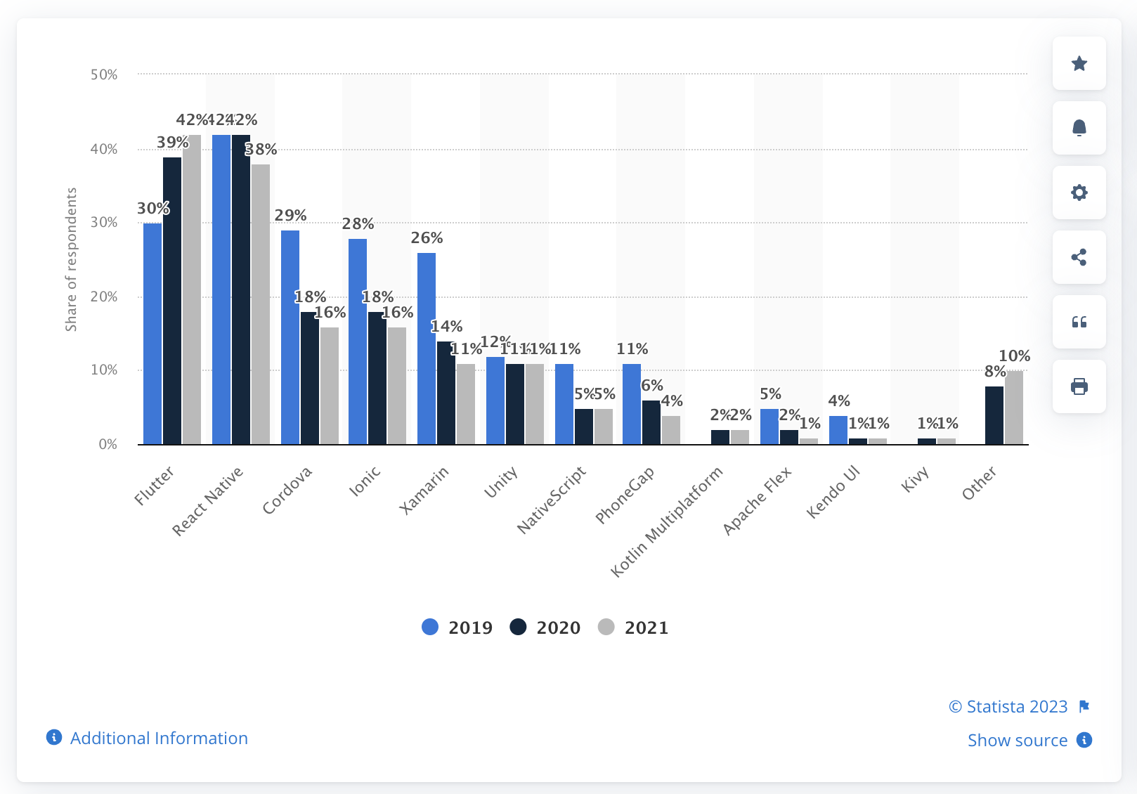

Slide 13

Open Source Platform
1
It's an open-source platform which make it available for use and study by start-ups for any given purpose. It's more or less like an open collaboration.

Slide 14

Custom Design And Navigation
2
The modern API with customisation features in Flutter is a dream come true. It is perfect for navigation needs and does its own rendering using Skia.

Slide 15

Faster Development Cycle
3
Flutter is blazing fast! Yes, it take 25 seconds for full compilation in Flutter. Furthermore, the hot reload option in Flutter allows incremental compilation.

